Slide 1

Lecture # 04 preprocessing and decision tree

Slide 2

what is preprocessing?
What is Preprocessing? Preprocessing refers to the steps taken to prepare raw data for analysis. It involves cleaning, transforming, and organizing data to make it suitable for mining and analysis tasks. Preprocessing is essential because real-world data often contains noise, missing values, inconsistencies, and irrelevant information.

Slide 3

key steps in preprocessing:
a) Data Cleaning: This step involves identifying and correcting errors or inconsistencies in the data. It includes handling missing values, correcting errors, and removing outliers.
b) Data Transformation: Data transformation techniques are used to convert the data into a format suitable for analysis. This may involve normalization, scaling, discretization, or encoding categorical variables.
c) Data Reduction: Data reduction techniques are used to reduce the size of the dataset while preserving its integrity. This includes techniques such as feature selection, dimensionality reduction, and instance selection.
d) Data Integration: Data integration involves combining data from multiple sources into a single, coherent dataset. This may involve resolving inconsistencies, merging datasets, and handling redundant information.

Slide 4

Importance of Preprocessing:
a) Improves Data Quality: Preprocessing helps improve the quality of the data by removing errors, inconsistencies, and irrelevant information.
b) Enhances Analysis Accuracy: Clean and well-preprocessed data leads to more accurate analysis results and better insights.
c) Reduces Processing Time: By removing noise, outliers, and irrelevant features, preprocessing reduces the computational burden and processing time of data mining algorithms.
d) Increases Model Performance: Preprocessing optimizes the data for modeling by ensuring that it meets the assumptions and requirements of the chosen algorithms.

Slide 5
Challenges in preprocessing:
Handling Missing Data: Dealing with missing values requires careful consideration to avoid bias or distortion in the analysis.
Feature Selection: Selecting the right set of features is challenging and requires domain knowledge and experimentation.
Computational Complexity: Preprocessing large datasets can be computationally intensive and may require efficient algorithms and techniques.

Slide 6
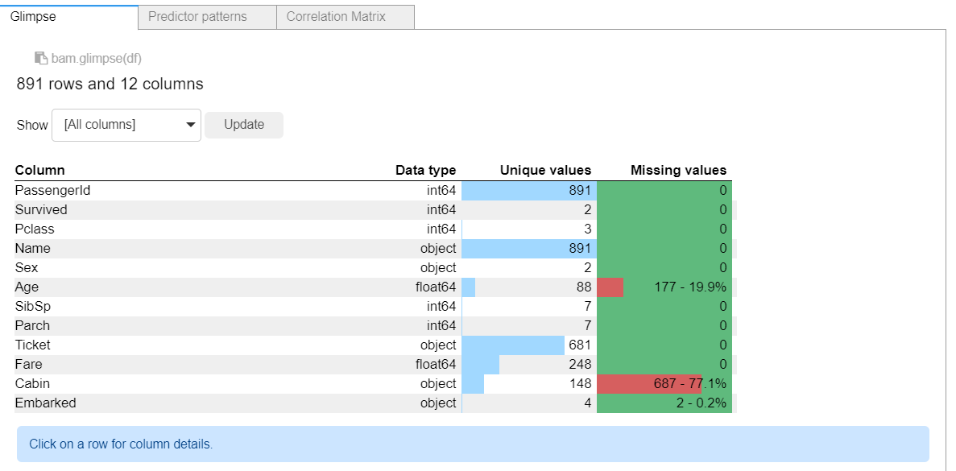
First of all, Explore the dataset

Slide 7
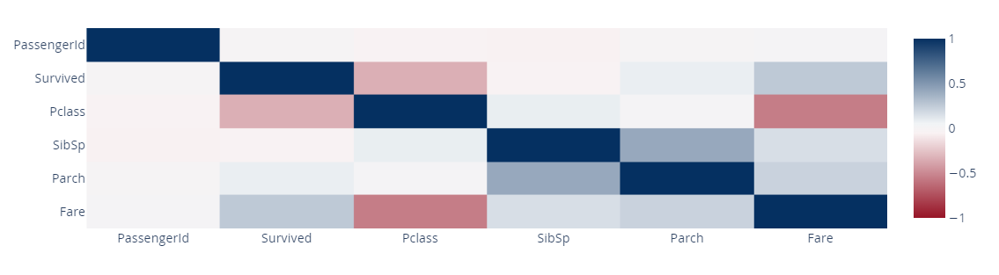
Correlation matrix
Visualize Relationships: Correlation matrices can be visualized using heatmaps, making it easier to interpret the relationships between variables at a glance. Heatmaps provide a visual representation of the correlation coefficients, with warmer colors indicating stronger correlations.

Slide 8

Techniques: ( Data Cleaning)
When you are working with raw data, instances of duplicate data, missing data or inconsistent data can occur. If the data is not cleaned, then the trading strategy can give misleading performance results during the backtest, or it can give incorrect buy/sell signals while trading.

Slide 9
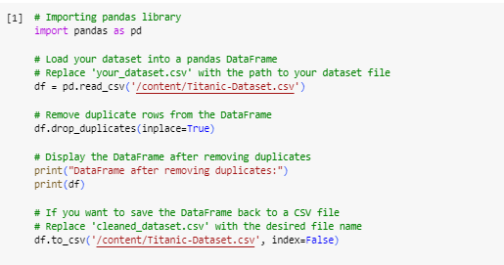
Dealing with Duplicate Values
Duplicate data means same data values getting repeated for certain timestamps. In Python, we can detect the occurrence of duplicate timestamps using the duplicated method and remove them using the drop_duplicates method.

Slide 10
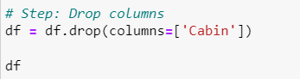
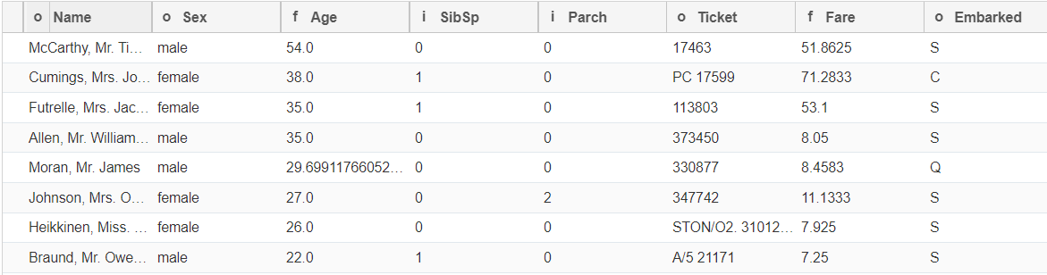
Drop Column

Slide 11
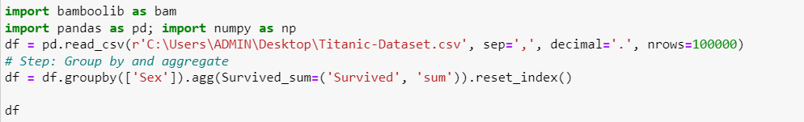
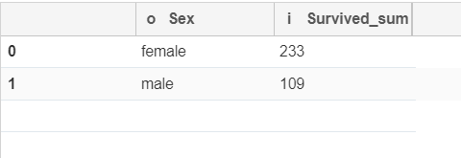
Group By: how many male and female survived

Slide 12
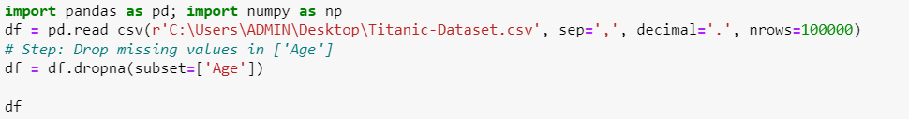
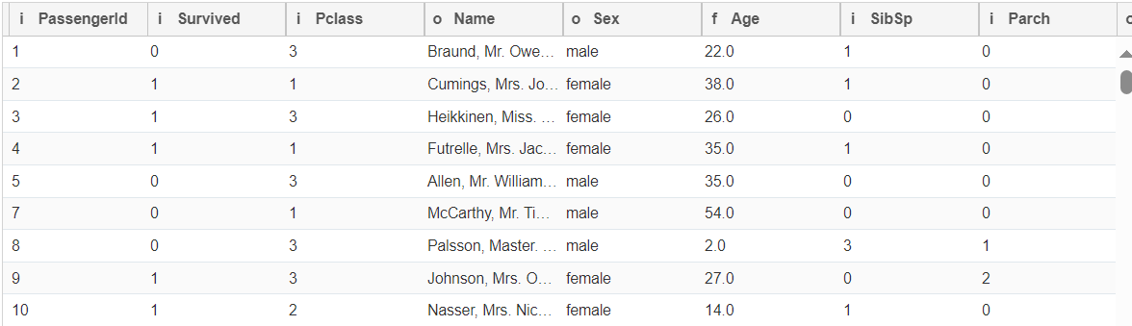
Dealing with Missing Data: Drop missing values

Slide 13
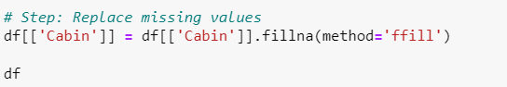
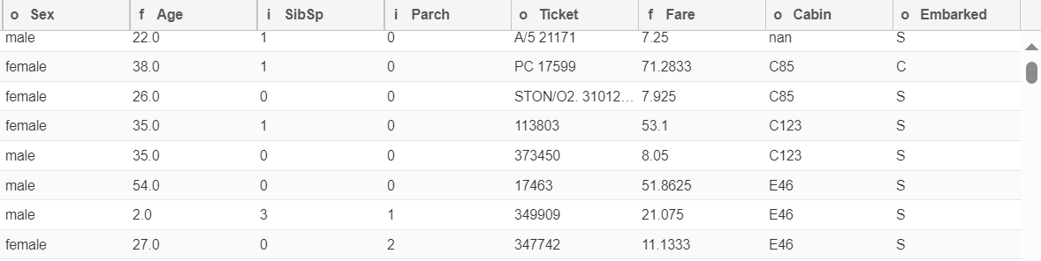
Find and Replace missing values: Forward Fill (last valid value fill)

Slide 14
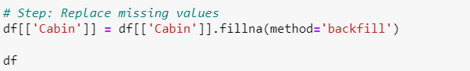
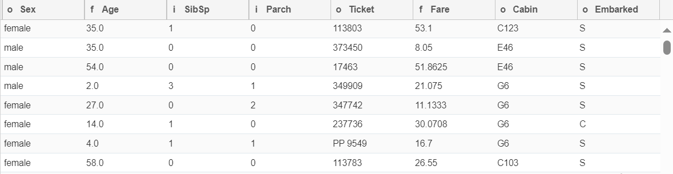
Find and Replace missing values: Backward Fill (Next Valid Value Fill)

Slide 15
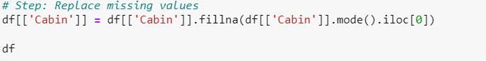
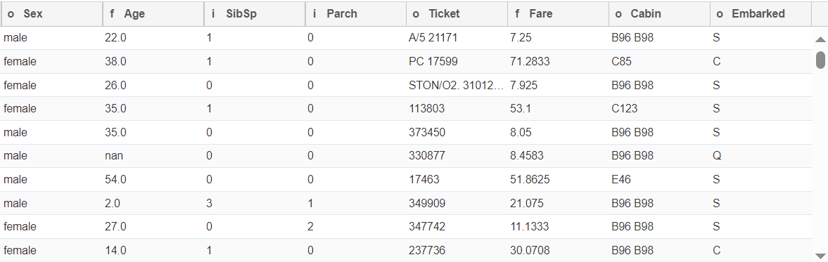
Find and Replace missing values: Mode (Most Frequent Value)

Slide 16
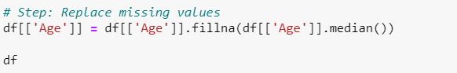
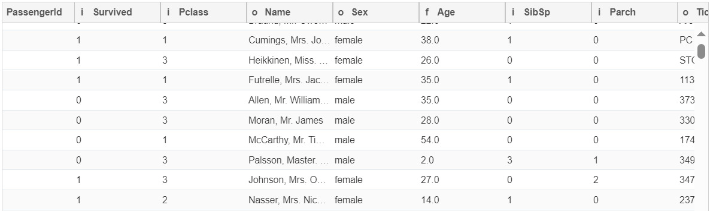
Find and Replace missing values: Median

Slide 17
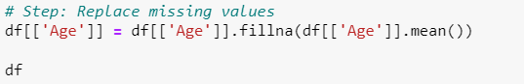
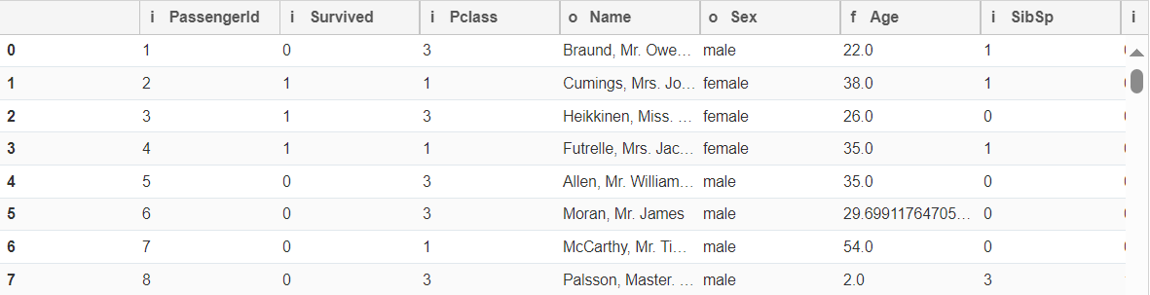
Find and Replace missing values: Mean

Slide 18
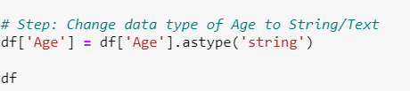
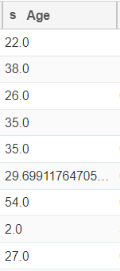
Change datatype of Age to String:
Float to string

Slide 19
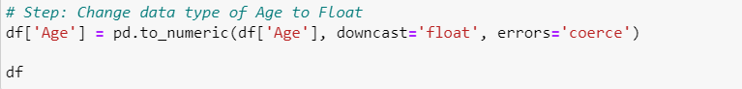
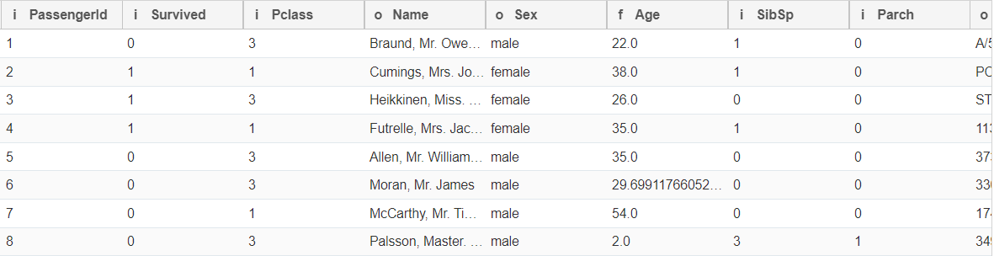
Change datatype to float

Slide 20
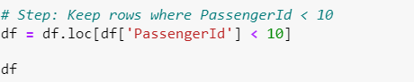
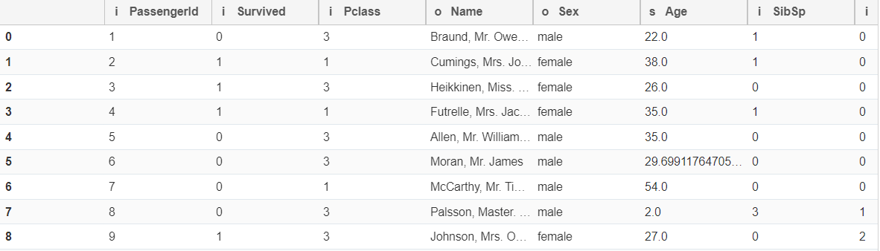
Filter Rows Based on condition:

Slide 21
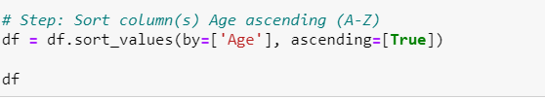
Sort column by Ascending Order

Slide 22
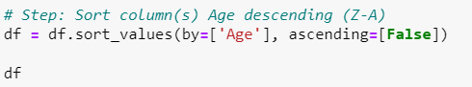
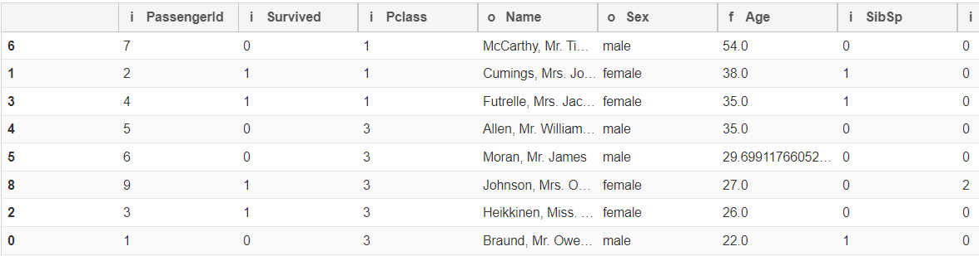
Sort column by Descending Order

Slide 23
Decision Tree
Decision trees are hierarchical structures that represent a sequence of decisions based on features to predict the value of a target variable.
They mimic human decision-making processes by partitioning the data into subsets based on the values of input features.
Each internal node of the tree represents a decision based on a feature, and each leaf node represents the predicted outcome.

Slide 24
Steps for decision tree in knime
Data Import: Start by importing your dataset into KNIME using the appropriate nodes for your data format (e.g., CSV Reader for CSV files, Database Reader for databases).
Data Preprocessing: Perform any necessary preprocessing steps on your data to clean, transform, and prepare it for modeling. This may include handling missing values, encoding categorical variables, and scaling numerical features.
Decision Tree Learner Node: Drag and drop a "Decision Tree Learner" node from the "Modeling" category onto the workflow canvas. This node is responsible for training the decision tree model on your dataset.
Configuration: Double-click on the Decision Tree Learner node to configure its settings. Here, you can specify the target column (the variable you want to predict) and any optional parameters for tree construction, such as maximum depth, minimum node size, or pruning options.
Data Splitting: Optionally, you may want to split your dataset into training and testing subsets to evaluate the performance of the decision tree model. Use nodes like "Partitioning" or "Partitioning (Train/Validate/Test)" to split the data accordingly.
Model Application: Connect the output port of the Decision Tree Learner node to a "Decision Tree Predictor" node, which applies the trained model to new data. If you split your dataset, connect the testing subset to the Decision Tree Predictor node to make predictions on unseen data.
Evaluation: Use evaluation nodes such as "Scorer" or "ROC Curve" to assess the performance of the decision tree model. These nodes calculate metrics like accuracy, precision, recall, and area under the curve (AUC) to evaluate how well the model generalizes to new data.
Visualization: Visualize the decision tree structure using the "Decision Tree Viewer" node, which provides an interactive visualization of the tree's nodes, branches, and decision rules. This visualization helps interpret the model's decisions and understand its predictive behavior.
Further Analysis: Depending on your analysis goals, you can perform additional tasks such as model optimization, feature selection, or ensemble modeling (e.g., random forests) to improve the performance of your decision tree model.
Execution: Execute the workflow to run each node and generate results. KNIME provides various options for executing workflows locally or on remote servers, depending on your computing resources and requirements.

Slide 25
Decision Tree Classification Using KNIME:

Slide 26
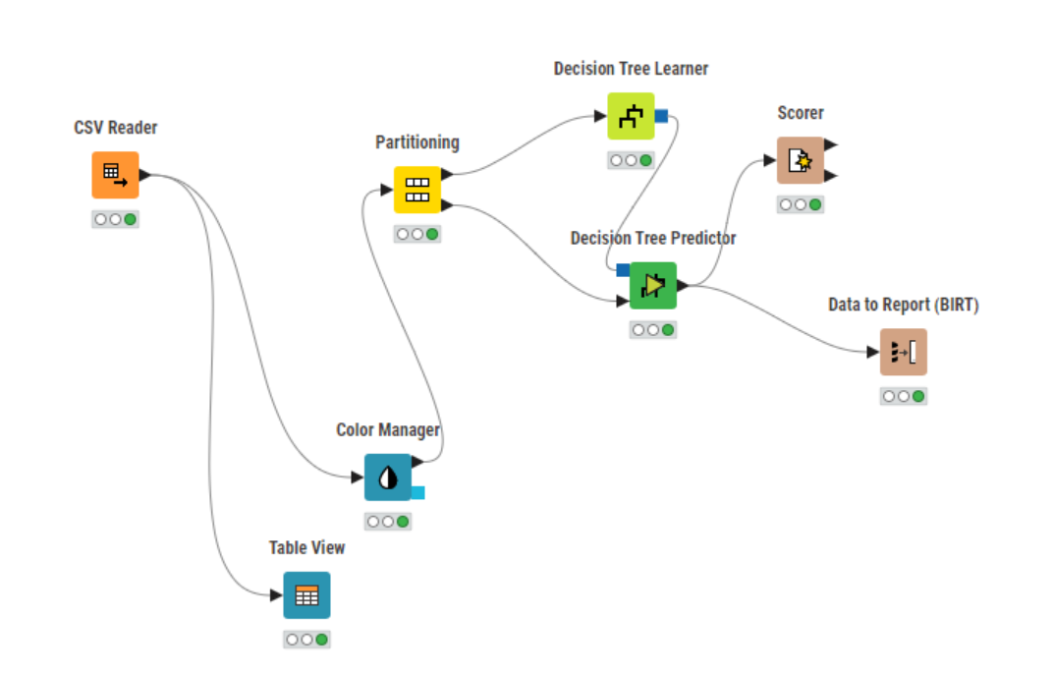
Decision Tree In KNIME:

Slide 27
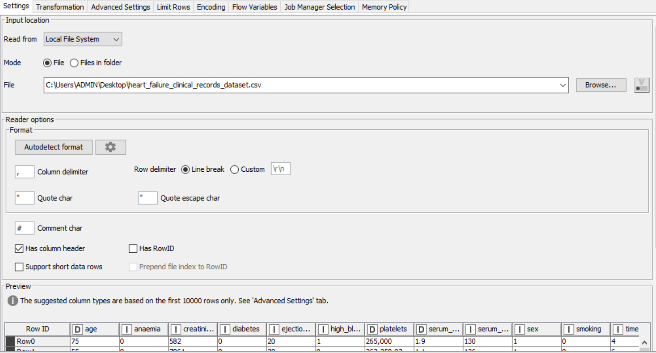
Reading csv configuration:

Slide 28
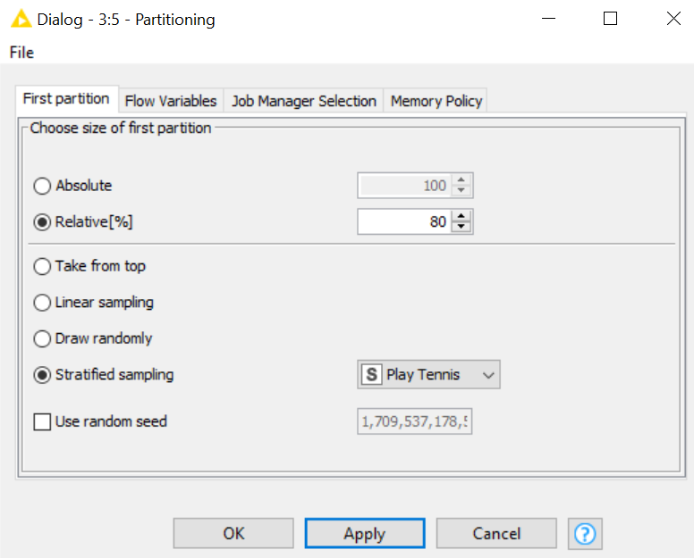
Partitioning configuration:

Slide 29
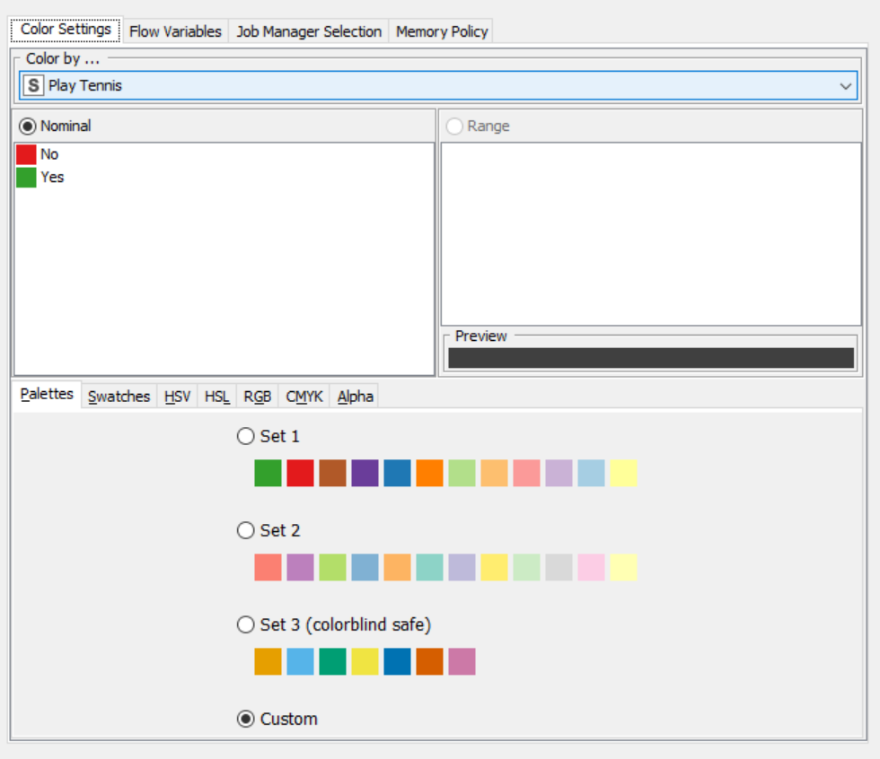
Color manager configuration:

Slide 30
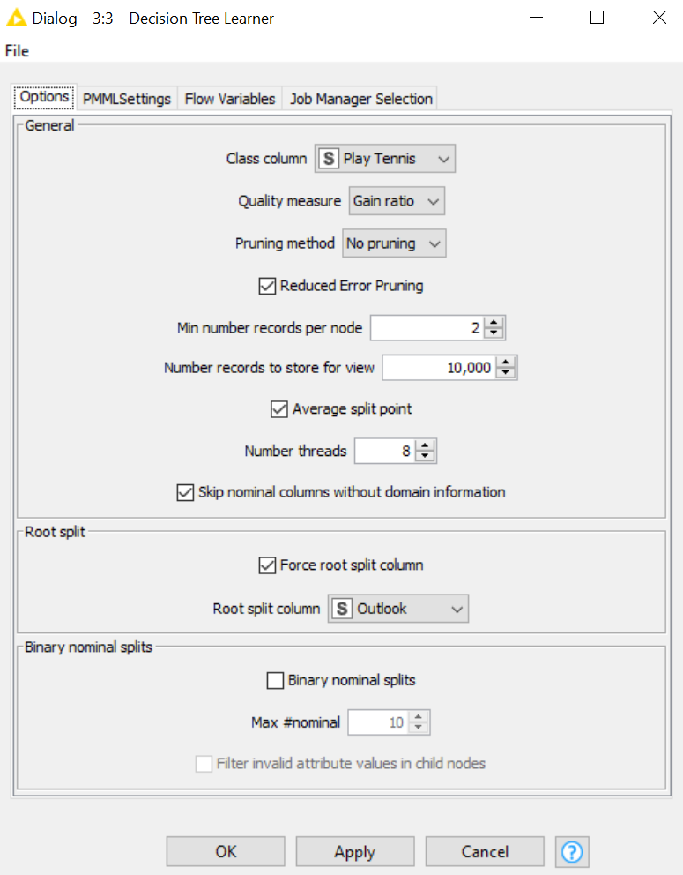
Decision tree learner configuration:

Slide 31
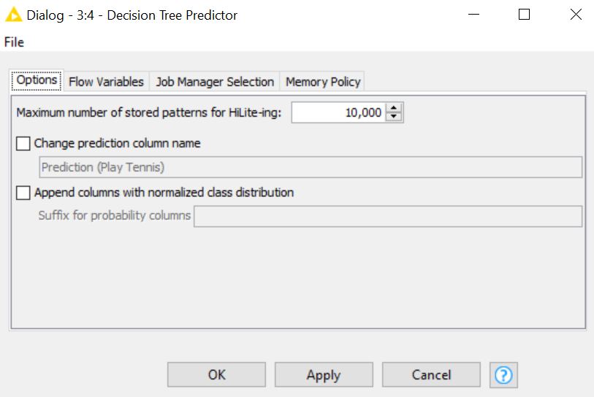
Decision tree predictor configuration:

Slide 32
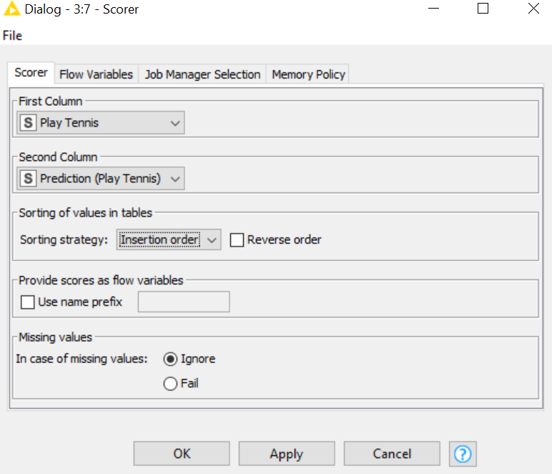
Scorer configuration:

Slide 33
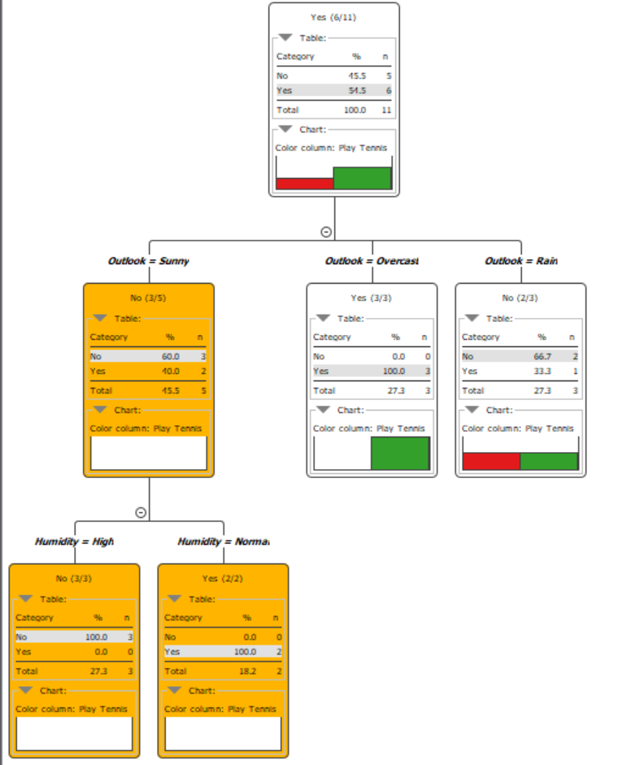
Decision tree

Slide 34
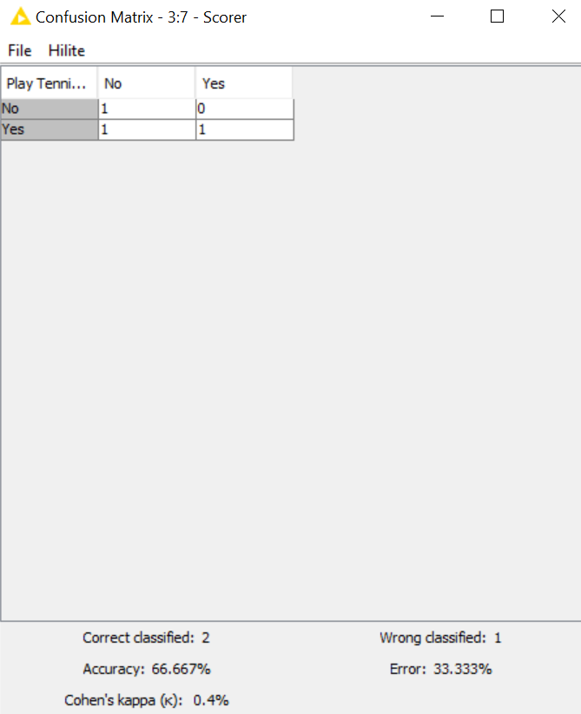
Model Accuracy:

Slide 35
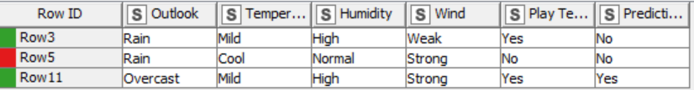
Report:

Slide 36

Decision Tree Classification Using Code:

Slide 37
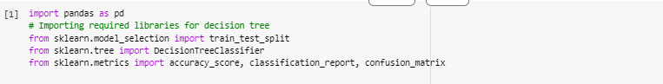
Step 1 : Import Necessary Libraries:

Slide 38
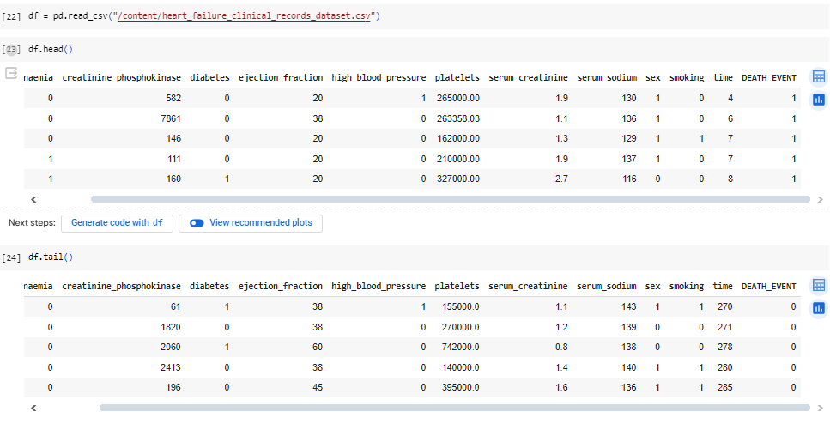
Step 2 : Read CSV

Slide 39
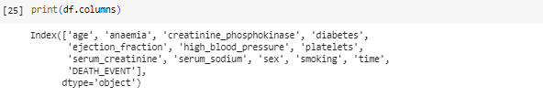
Step 3 : Check Columns for Feature Selection

Slide 40
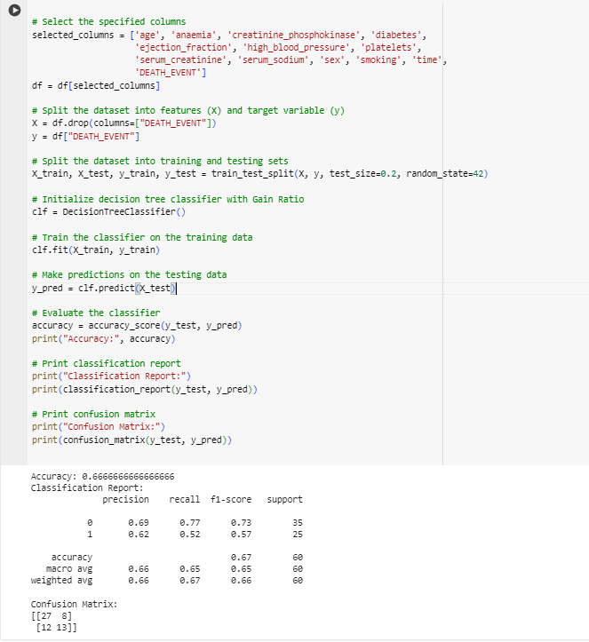
Feature Selection

Slide 41
Split dataset into features and target variabl

Slide 42
Split dataset into train and test

Slide 43
Apply Decision Tree Classifier:

Slide 44
Output with Accuracy:

Slide 45
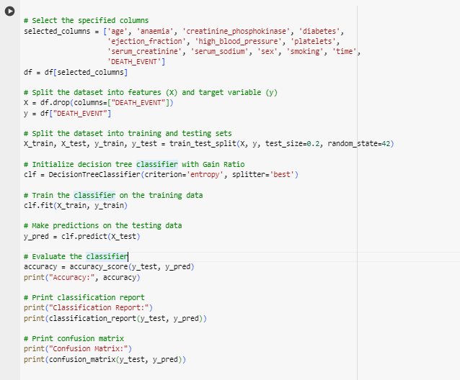
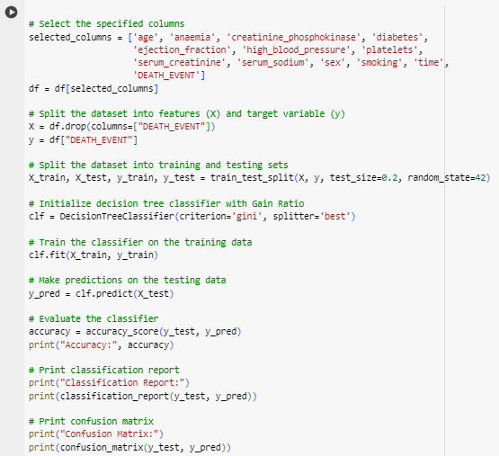
Optimize the Accuracy using Gini Index or Information Gain Techniques:

Slide 46
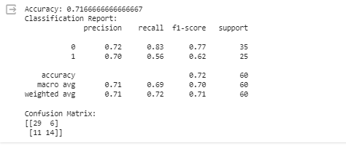
Output with Optimize Accuracy: using (Entropy or information Gain)

Slide 47
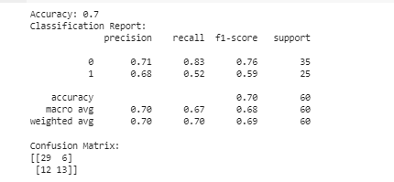
Output with Optimize Accuracy: using (Gini Index)

Slide 48

Tasks:
Lab Tasks/Practical Work
1. Using python implement Decision Tree Algorithm on Diabetes Dataset the chances of diabetes in a person. visualize the results of the model in the form of a confusion matrix using matplotlib and seaborn.
2. Using Knime implement Task # 01.
3. Using python perform the parameter tuning to optimize the Decision Tree performance and compare the results with task # 1.

